Slide 1


Slide 2


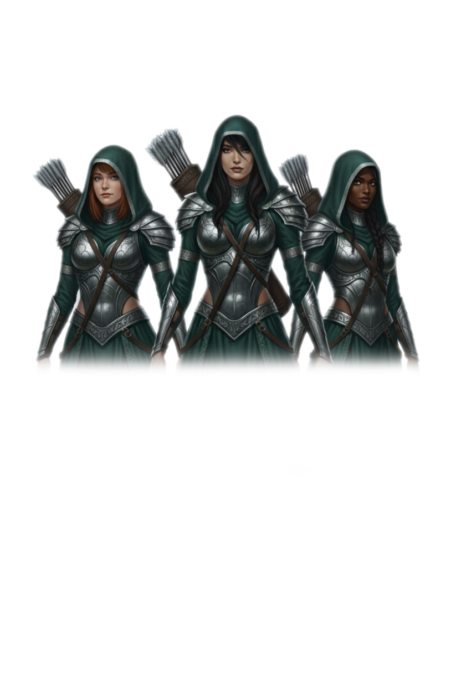




TEAM NAME

Slide 3
TEAM DETAILS & DECLARATION
Full Name (First & Last Name) | University Name | NIC | Contact Number (Mobile) | Email Address
I’m [Name] , have read and agree to terms and conditions of the Artemia 1.0 on behalf of myself and the team.
Signature : [Signature]
Date : [Date]

Slide 4
01 . PROBLEM & PRIORITIZTION
Theme:
Women’s Safety(Teams can explore any sub-topic or approach related to women’s safety,
e.g. apps, wearable devices, awareness platforms, monitoring solutions, VR/AR experiences, etc.)
What to include:
• Describe the problem you want to address related to women’s safety.
• Who is affected and how? (e.g., commuters, students, women in public spaces)
• Why does this problem matter?
• What negative consequences exist if it’s not addressed?
• If there are multiple aspects of the problem, highlight the most critical one your design will
focus on.
Tip: Use real-life examples, statistics, or scenarios to make your problem relatable.

Slide 5
02 . PROPOSED SOLUTION
What to include:
• Describe your UI/UX design idea to address the problem.
• Explain how users will interact with your solution (app, website, wearable interface, VR/AR
experience, etc.).
• Highlight key features or design elements that make your solution unique, user-friendly, and
effective.
• You do not need to implement the solution—focus on the concept, flows, visuals, and experience.
Important:
The final product concept should be connected to a web, desktop, or mobile application, even if
not fully implemented.
Tip:
Think creatively—your design can explore futuristic technologies like VR, AR, Device or AI for user
experience. but the final product should be connected to a web/desktop or mobile application

Slide 6
03. PROJECT SCOPE & HIGH – LEVEL PLAN
What to include:
• Define what your design project will cover (user interface, experience flows, interactive prototypes,
visual elements).
• Outline a high-level plan or steps you’ll follow
(e.g., research → wireframe → prototype → user testing → presentation).
• Mention tools, platforms, or design resources you’ll use (Figma, Adobe XD, Blender, Unity, etc.).
Tip: Be clear about what your team intends to deliver visually and conceptually

Slide 7
04 . PROJECT DELIVERY
What to include:
• Describe how your design will be presented or shared (interactive prototype, mockups, storyboard, VR/AR demo concept).
• Explain expected impact or user experience improvements.
Optional: mention potential challenges in designing the interface or experience and how you plan to overcome them.
You may also include a proposal video link here to visually demonstrate your concept and design flow.
Tip: Focus on the user experience, usability, and creativity—show how your design concept makes women feel safer and empowered.

Slide 8


